Slide 1
Phonics and Early Reading Workshop for parents

Slide 2
What is the Little Wandle Letters and Sounds Revised Program?
Wandle and Little Sutton English Hubs
Revised from Letters and Sounds
Uses latest research about how children learn best
Mastery approach
Notes:
Wandle and Little Sutton English Hubs – in top 5% of country for outcomes in Y1 screening Little
Complete teaching programme meeting all the expectations of the National Curriculum, the Ofsted Deep Dive into reading and preparing your children to go beyond the expectations of the Phonics Screening Check.
Draws on research about how to ensure learning stays in children’s long term memory and how best to enable children to apply their learning to become highly competent readers.
all children in the class learn the same content at the same time and it applies the principle of all the children keeping up.

Slide 3
What is phonics?
The ultimate goal of teaching phonics is that children read fluently, recognising most words instantly and using phonics to decode any unknown words.
Short term memory to long term memory
Automaticity
Repeated Practice
Notes:
This means that phonics knowledge needs to be embedded in long-term memory so that its application becomes automatic. Repeated, spaced practice is by far the most effective way of transferring knowledge from short- to long-term memory.
Effective phonics teaching offers repeated practice at the point of learning and returns to practise the same elements again at intervals over an extended period, which develops automaticity.
Practice makes permanent like any well trodden path

Slide 4
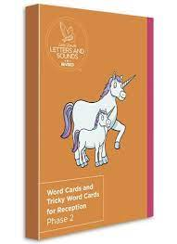
The nitty gritty of phonics
What is a phoneme?
The smallest unit of sound that can be identified in words
What is a grapheme?
A letter or group of letters used to represent a particular phoneme when writing
What are pure sounds?
What is blending?
To combine individual phonemes into a whole word, working all the way through from left to right.
What are tricky words?
High-frequency words that, although decodable in themselves, cannot be decoded by children using the GPCs they have been taught up to that point.

Slide 5
Progression of Teaching Reception
Recap of Phase 1 (environmental sounds)
Autumn 1 & 2: Phase 2 simple GPCs – s,a,t,p,i,n,m,n,d, g, o, c, k, ck, e, u, r, h, b, f, lff ll ss j v w x y z zz qu ch sh th ng nk
Spring 1 & 2:Phase 3 ai ee igh oa oo oo ar or ur ow oi ear air er and longer words with double letters; suffixes –ing, -ed, -er, -est longer words and compound words
Summer 1 & 2: Phase 4 Short vowels with adjacent consonants, suffixes –ing, -ed, -er, -est; longer words and compound words
Notes:
second week of the Autumn term to help establish routines and set up behaviours for learning.
All children should progress through the GPCs in order.
Some children may take longer to learn to blend. They should not be deprived of learning new GPCs. Instead, every effort should be put in place to give these children additional daily blending practice.
Spring term children who are not blending need additional daily blending practice. Each step of the reading process is fully secured before moving on and children always get the teacher-led blending practice before reading any words independently

Slide 6
Progression of Teaching Year 1
Review phase 3 & 4
Autumn 1 – Spring 2: Phase 5 – alternative pronunciations:
/ai/ ay play
/oi/ oy toy
/or/ au aur oor al author dinosaur floor walk
Summer 1: Phonics screening check review
Summer 2: Phase 5 alternative consonants
/ch/ tch ture match adventure
/sh/ ti ssi si ci potion mission mansion delicious
/or/ augh our oar ore daughter pour oar more
Notes:
Summer term assessments from Reception to identify gaps in learning for classes and individuals. This will ensure that all children are secure before they start learning the Phase 5 GPCs.
We can learn from the considerable research in maths mastery, which identifies that differentiation is not through subject content, but through urgent intervention for those children who are not meeting objectives and, for those who have rapidly grasped the concept, enrichment rather than acceleration.

Slide 7
Phonics into Reading
Underpins the curriculum
Clearly impacts on achievement
Impacts happiness and life expectancy
Notes:
1) The National Curriculum for English (2014) aims to ensure that all pupils:
• read easily, fluently and with good understanding
• develop the habit of reading widely and often, for both pleasure and information
• acquire a wide vocabulary, an understanding of grammar and knowledge of linguistic conventions for reading, writing and spoken language. BUT WE WANT TO GO BEYOND THE NATIONAL CURRICULUM
2) Our curriculum is based around reading – story time, reading in non-core, books to centre writing, guided reading
3) Reading clearly impacts on achievement. There is considerable research to show that children who enjoy reading and choose to read benefit not only academically, but also socially and emotionally.

Slide 8
Early Reading
Phonic decoding skills must be practised until children become automatic and fluent reading is established.
Decoding – practicing secure phonic knowledge
Prosody- Rhythmic and intonation = expressive reading; conveys meaning and add ‘life’ to reading.
Comprehension – VIPERS: vocabulary, inference, prediction, explanation, retrieval, sequencing
Notes:
Talk to Mrs Barnard for enrichment opportunities if you feel its needed

Slide 9
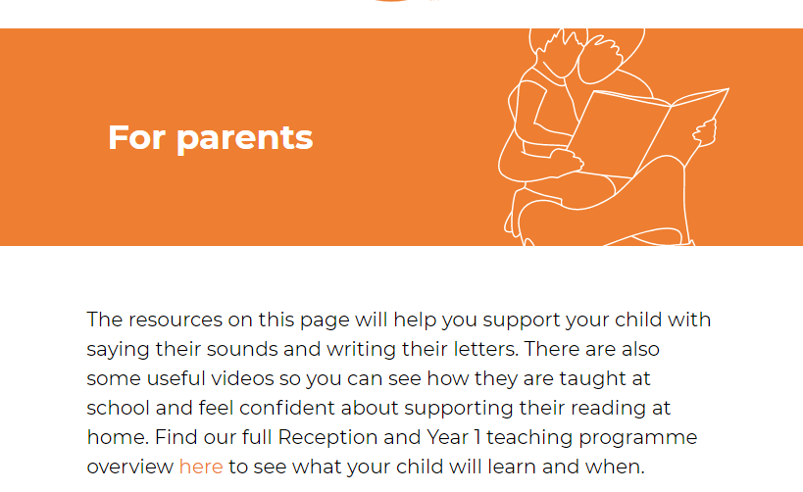
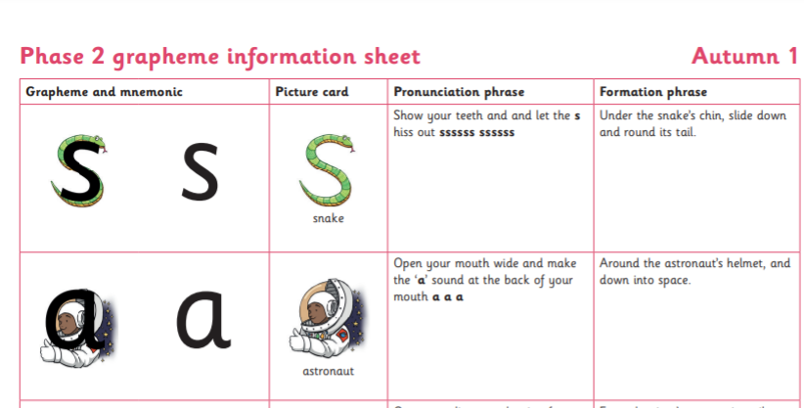
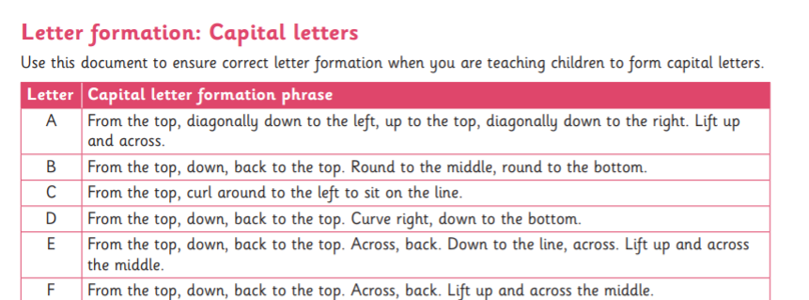
How to help at home
Parent’s guide
Letter formation and pronunciation guide
Reading Practice books
Sharing books – read range of genres and authors, read to children, quality sharing time, reading for pleasure, talk about books – model how to be a reader.
Notes:
2) Documents are on school website but can be emailed/ printed out. Children in R practice letter formation in print before being moved onto cursive at teacher discretion

Slide 10
Thank you…

